Slide 1
Chapter 15
Integrated Services Digital Network
ISDN
Services
History
Subscriber Access
Layers
BISDN
WCB/McGraw-Hill
© The McGraw-Hill Companies, Inc., 1998

Slide 2
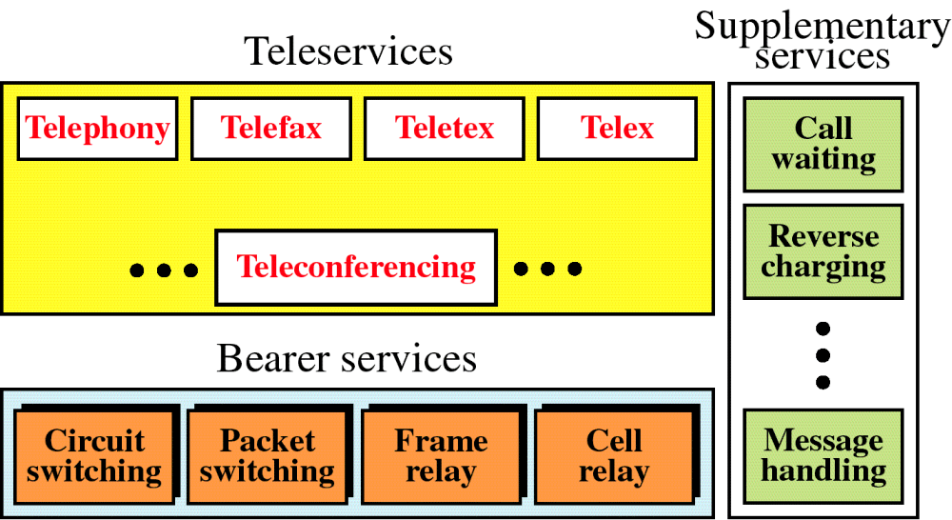
Figure 15-1
ISDN Services
WCB/McGraw-Hill
© The McGraw-Hill Companies, Inc., 1998

Slide 3
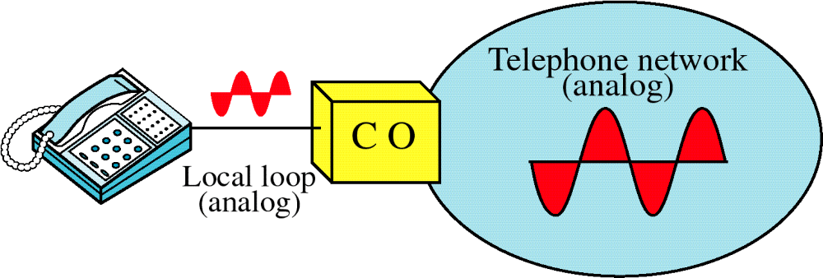
Figure 15-2
Voice over Analog Network
WCB/McGraw-Hill
© The McGraw-Hill Companies, Inc., 1998

Slide 4
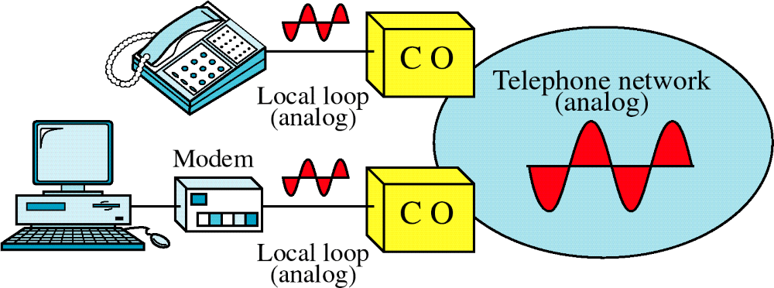
Figure 15-3
Voice and Data over Analog Network
WCB/McGraw-Hill
© The McGraw-Hill Companies, Inc., 1998

Slide 5
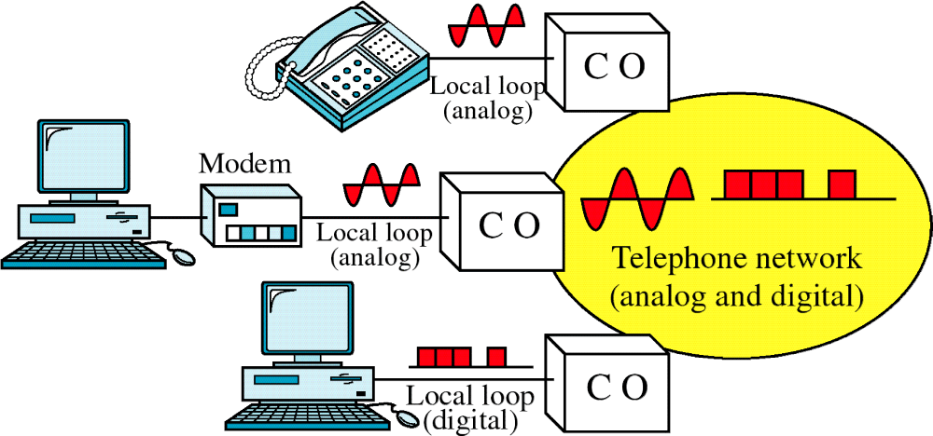
Figure 15-4
Analog and Digital Services
WCB/McGraw-Hill
© The McGraw-Hill Companies, Inc., 1998

Slide 6
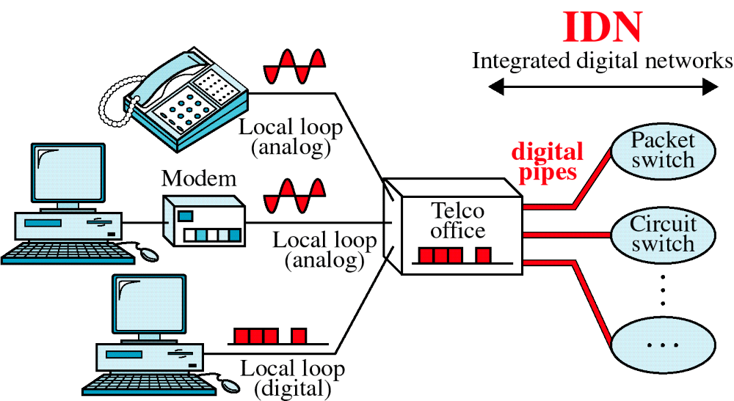
Figure 15-5
Integrated Digital Network
WCB/McGraw-Hill
© The McGraw-Hill Companies, Inc., 1998

Slide 7
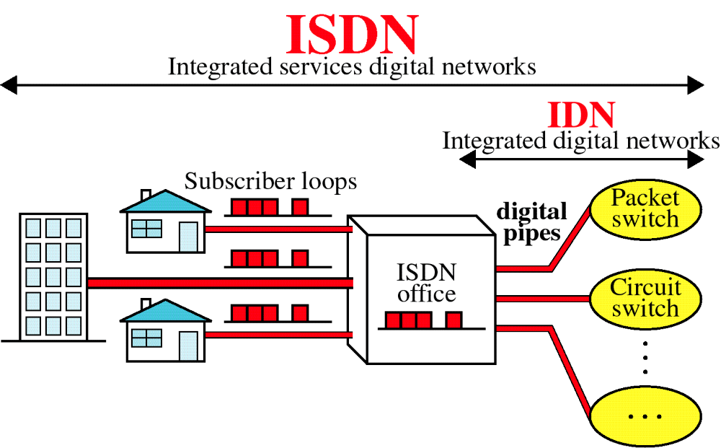
Figure 15-6
Integrated Services Digital Network
WCB/McGraw-Hill
© The McGraw-Hill Companies, Inc., 1998

Slide 8
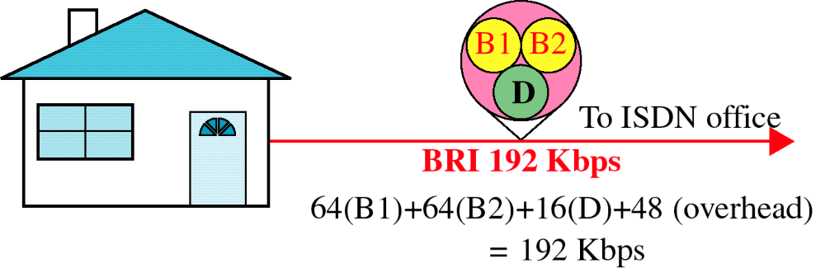
Figure 15-7
Basic Rate Interface
WCB/McGraw-Hill
© The McGraw-Hill Companies, Inc., 1998

Slide 9
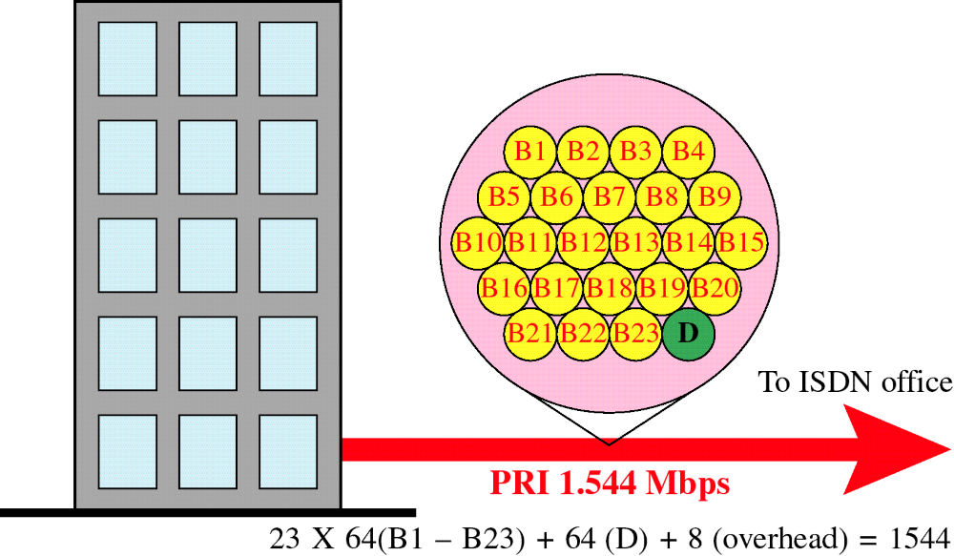
Figure 15-8
Primary Rate Interface
WCB/McGraw-Hill
© The McGraw-Hill Companies, Inc., 1998

Slide 10
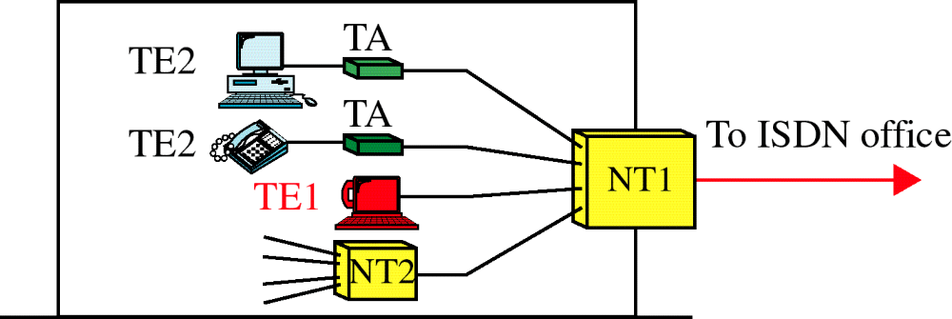
Figure 15-9
Functional Grouping
WCB/McGraw-Hill
© The McGraw-Hill Companies, Inc., 1998

Slide 11
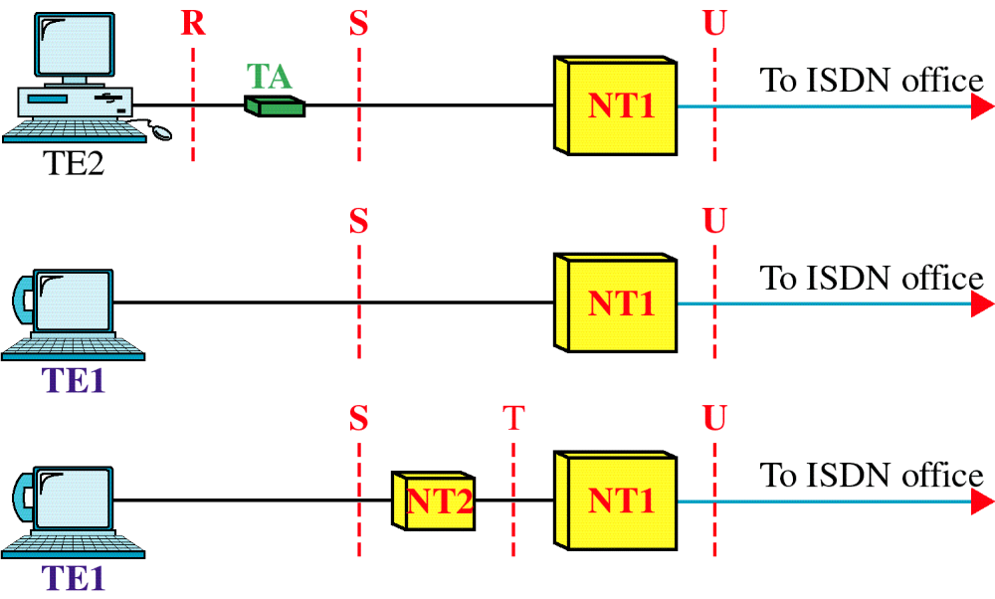
Figure 15-10
Reference Points
WCB/McGraw-Hill
© The McGraw-Hill Companies, Inc., 1998

Slide 12
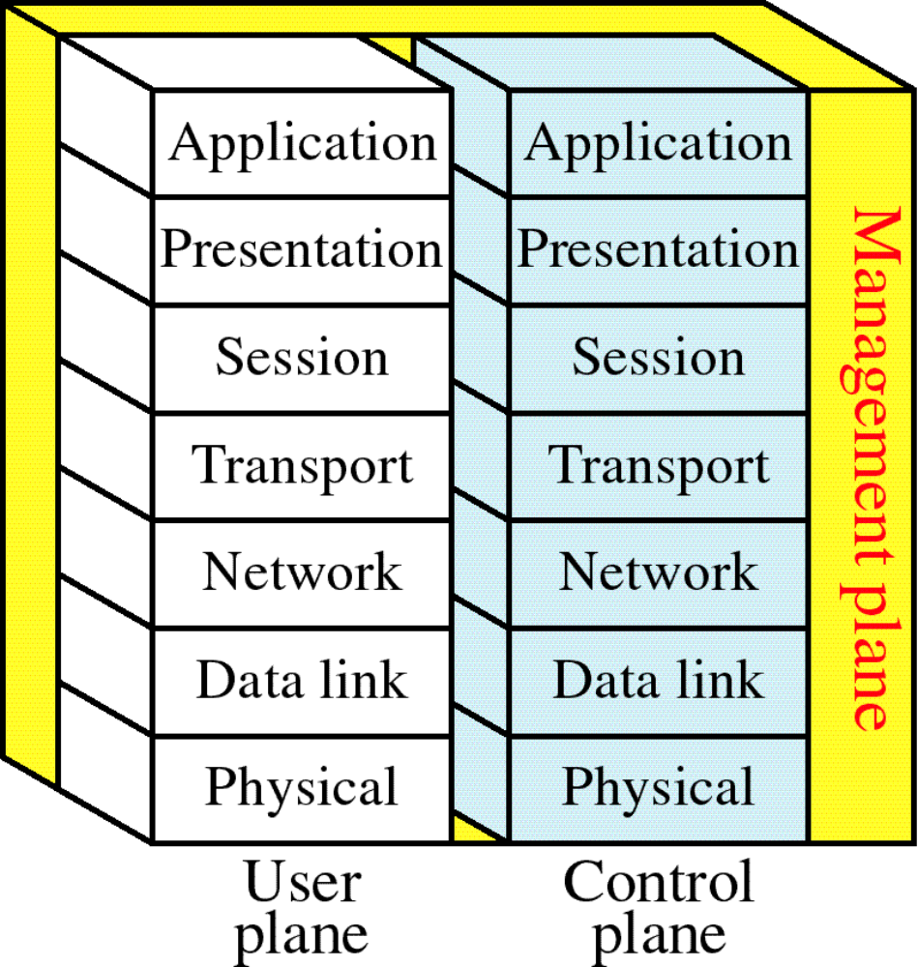
Figure 15-11
ISDN Layers
WCB/McGraw-Hill
© The McGraw-Hill Companies, Inc., 1998

Slide 13
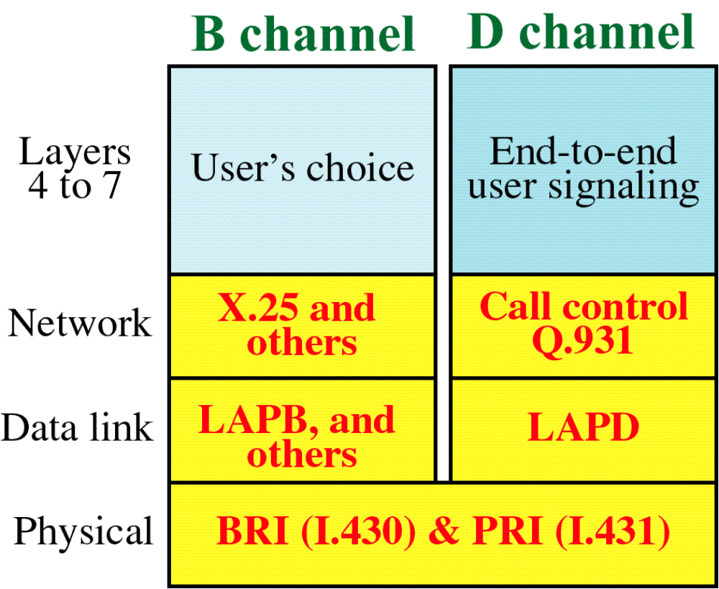
Figure 15-12
ISDN Layers for B and D Channels
WCB/McGraw-Hill
© The McGraw-Hill Companies, Inc., 1998

Slide 14
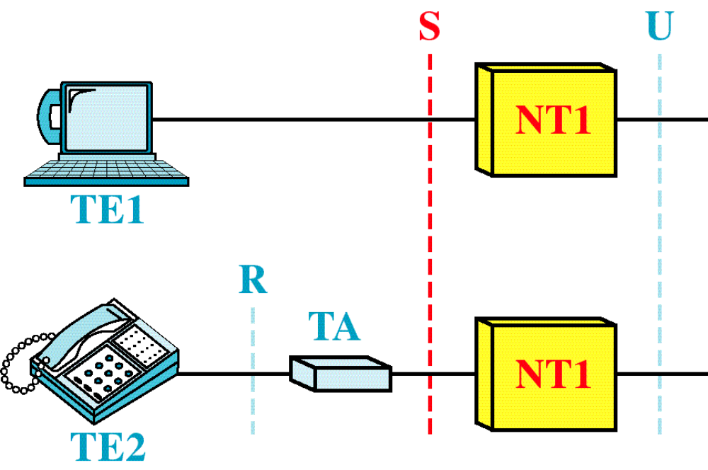
Figure 15-13
BRI Interfaces
WCB/McGraw-Hill
© The McGraw-Hill Companies, Inc., 1998

Slide 15
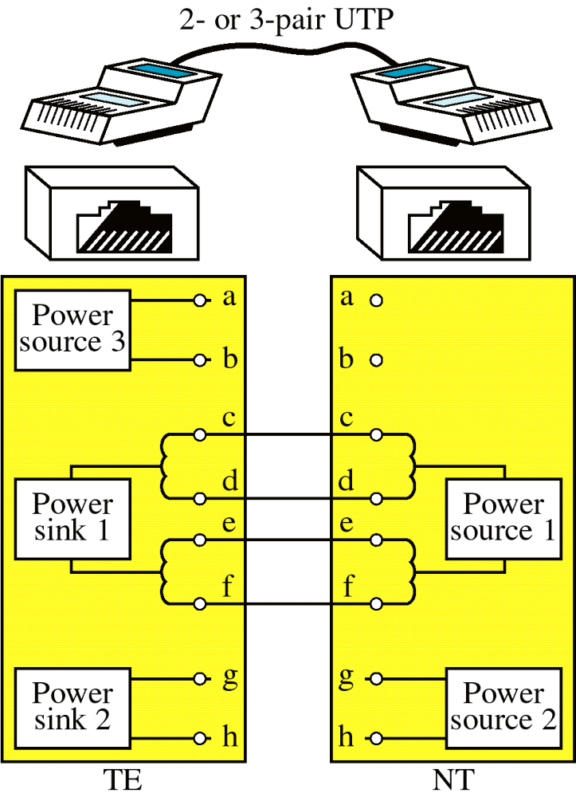
Figure 15-14
S Interface
WCB/McGraw-Hill
© The McGraw-Hill Companies, Inc., 1998

Slide 16
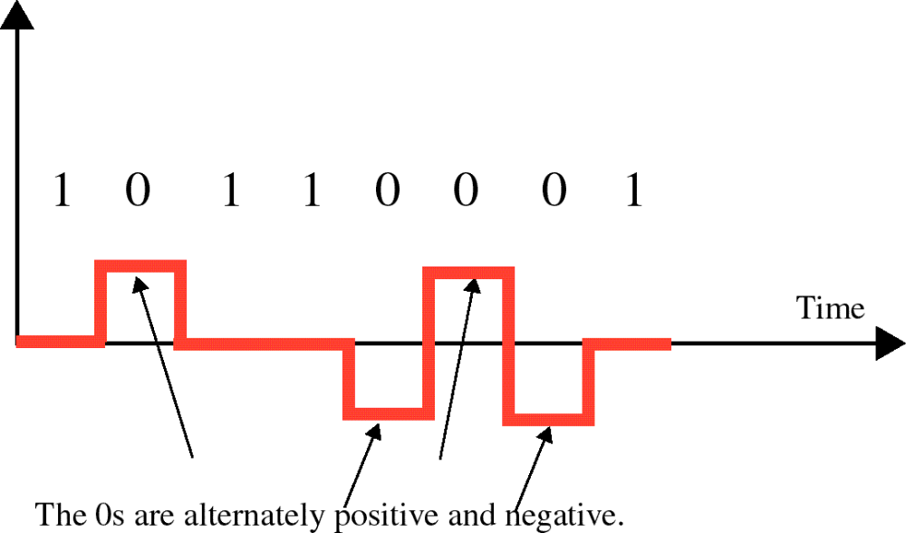
Figure 15-15
Pseudoternary Encoding
WCB/McGraw-Hill
© The McGraw-Hill Companies, Inc., 1998

Slide 17
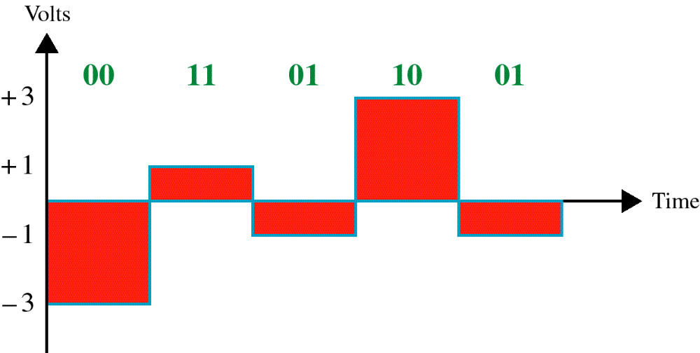
Figure 15-16
2B1Q Encoding
WCB/McGraw-Hill
© The McGraw-Hill Companies, Inc., 1998

Slide 18
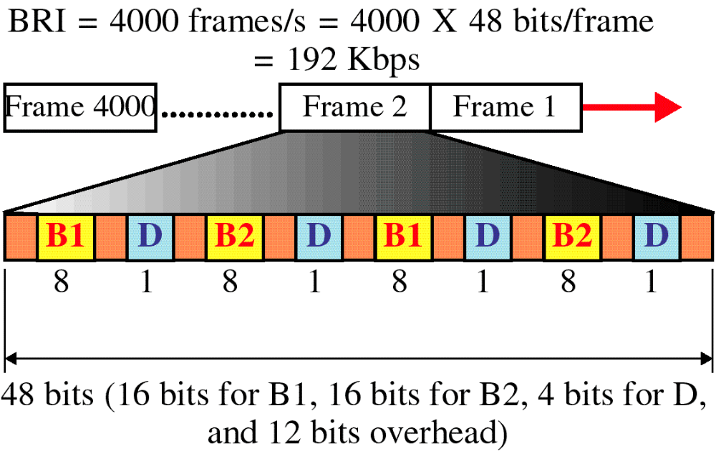
Figure 15-17
BRI Frame
WCB/McGraw-Hill
© The McGraw-Hill Companies, Inc., 1998

Slide 19
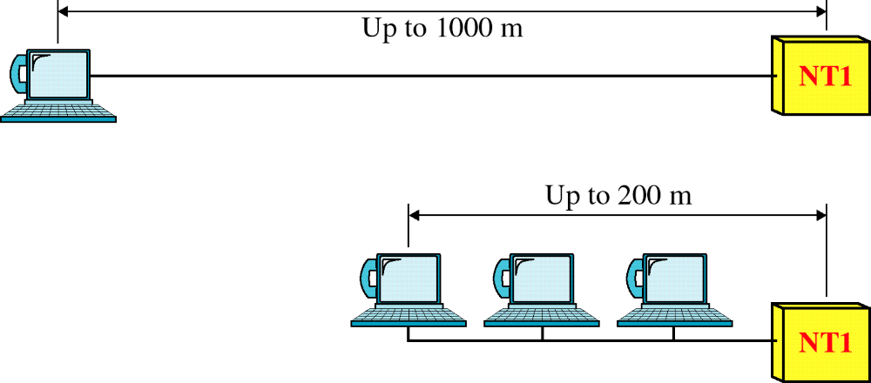
Figure 15-18
BRI Topology
WCB/McGraw-Hill
© The McGraw-Hill Companies, Inc., 1998

Slide 20
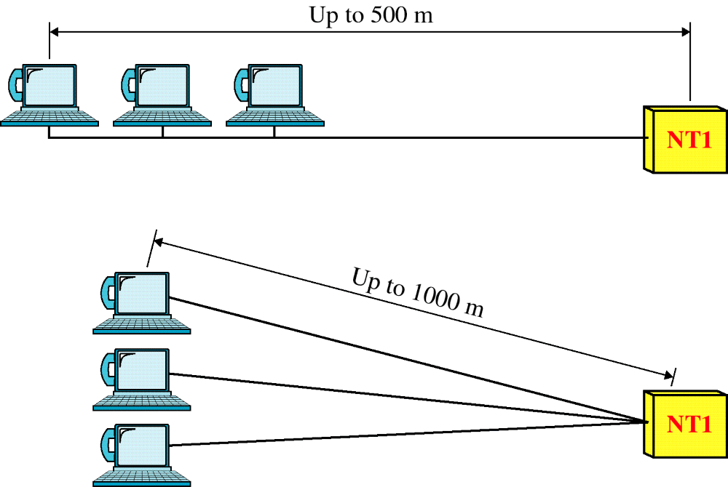
Figure 15-18-continued
BRI Topology
WCB/McGraw-Hill
© The McGraw-Hill Companies, Inc., 1998

Slide 21
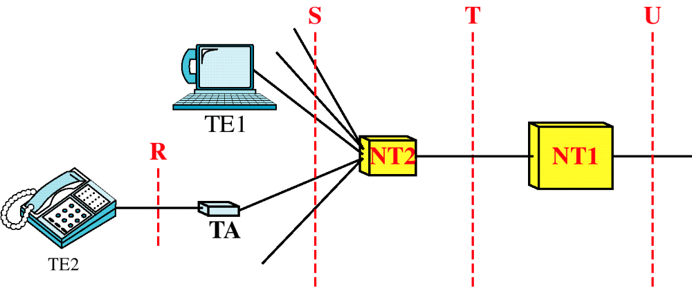
Figure 15-19
PRI Interfaces
WCB/McGraw-Hill
© The McGraw-Hill Companies, Inc., 1998

Slide 22
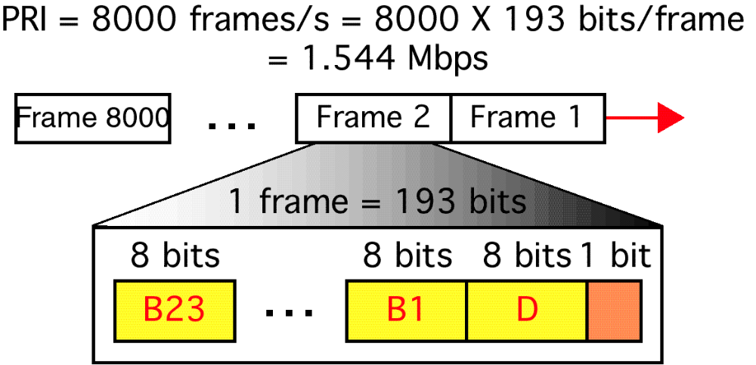
Figure 15-20
PRI Frame
WCB/McGraw-Hill
© The McGraw-Hill Companies, Inc., 1998

Slide 23
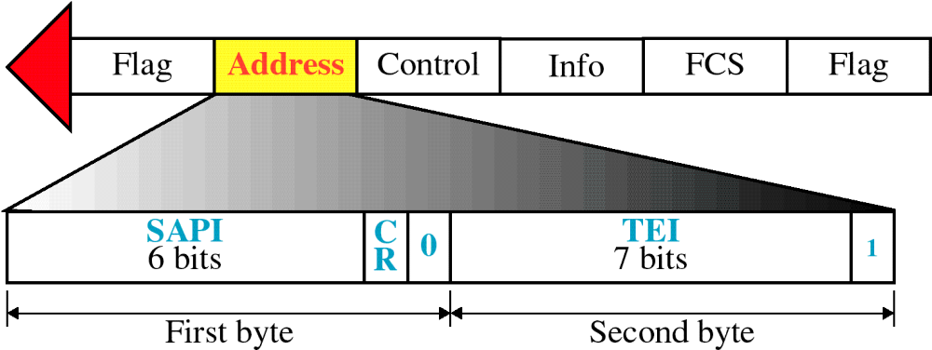
Figure 15-21
LAPD Address Field
WCB/McGraw-Hill
© The McGraw-Hill Companies, Inc., 1998

Slide 24
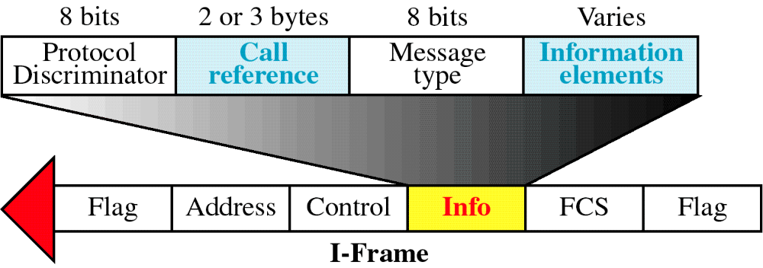
Figure 15-22
Network Layer Packet Format
WCB/McGraw-Hill
© The McGraw-Hill Companies, Inc., 1998

Slide 25
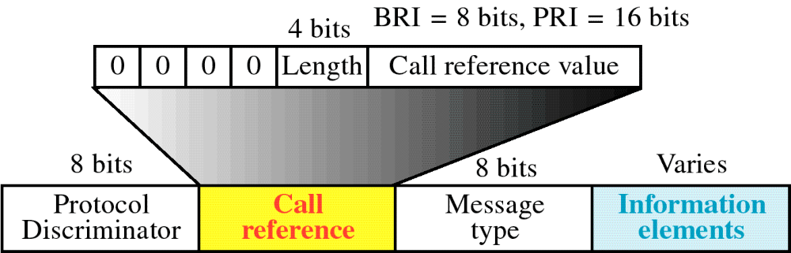
Figure 15-23
Call Reference Field
WCB/McGraw-Hill
© The McGraw-Hill Companies, Inc., 1998

Slide 26
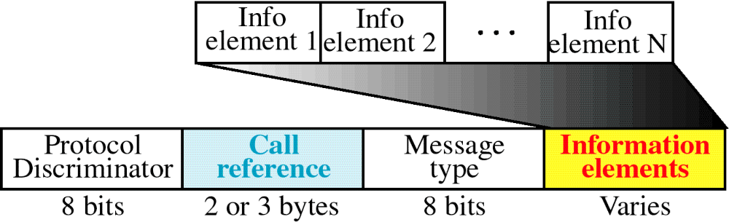
Figure 15-24
Information Elements
WCB/McGraw-Hill
© The McGraw-Hill Companies, Inc., 1998

Slide 27
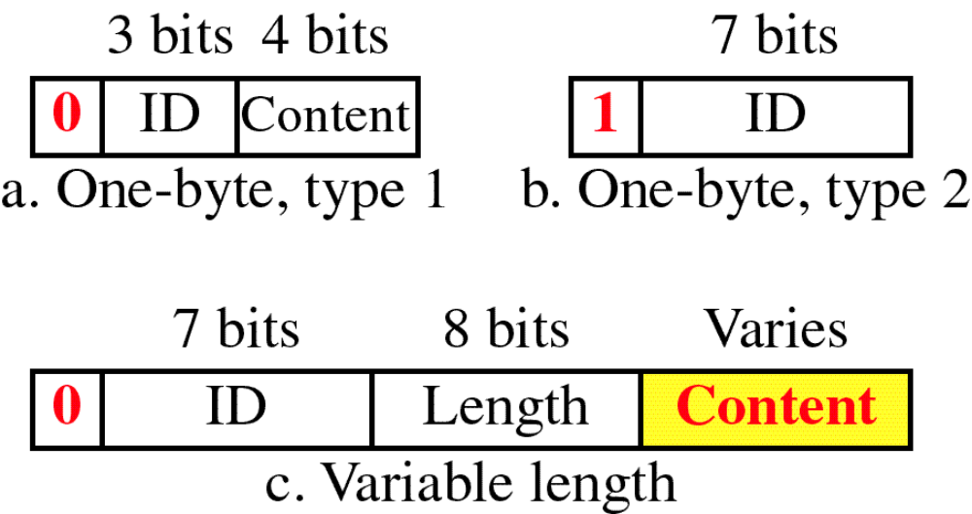
Figure 15-25
Information Element Types
WCB/McGraw-Hill
© The McGraw-Hill Companies, Inc., 1998

Slide 28
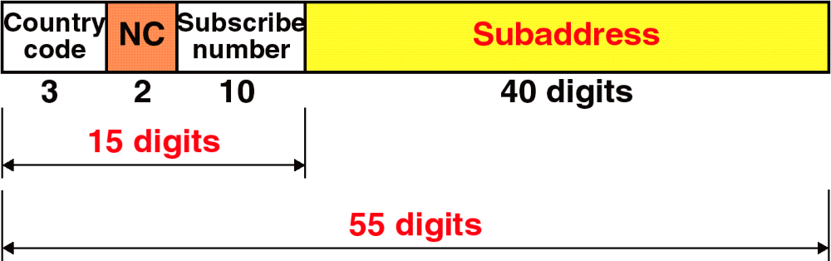
Figure 15-26
Addressing in ISDN
WCB/McGraw-Hill
© The McGraw-Hill Companies, Inc., 1998

Slide 29
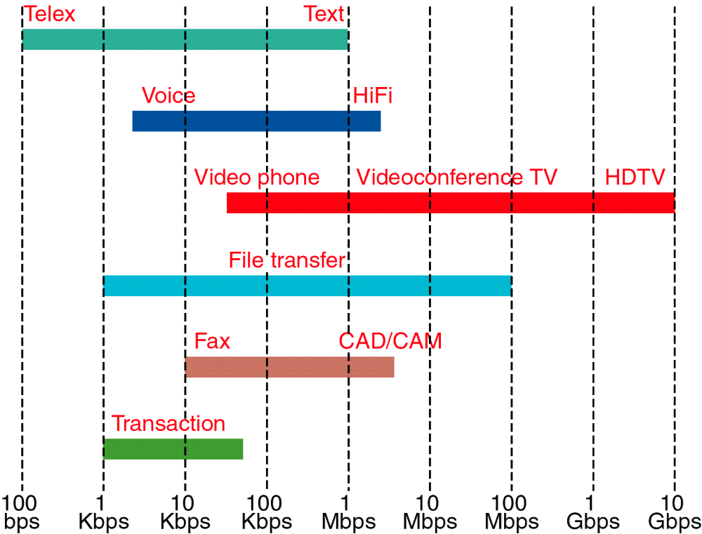
Figure 15-27
Bit Rates for Different Applications
WCB/McGraw-Hill
© The McGraw-Hill Companies, Inc., 1998

Slide 30
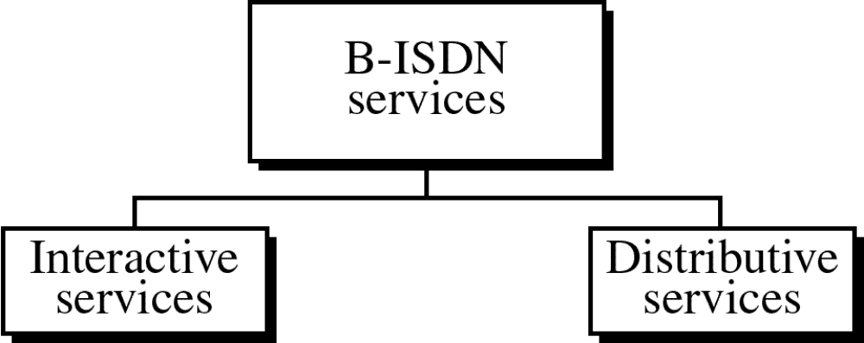
Figure 15-28
WCB/McGraw-Hill
© The McGraw-Hill Companies, Inc., 1998

Slide 31
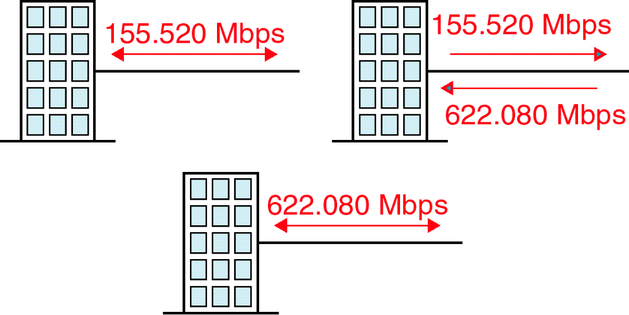
Figure 15-29
B-ISDN Access Methods
WCB/McGraw-Hill
© The McGraw-Hill Companies, Inc., 1998

